Slide 1

Analysis of Algorithms 1
(Fall 2013)
Istanbul Technical University
Computer Eng. Dept.
Chapter 10
Elementary Data Structures
Last updated: November 11, 2009

Slide 2
Purpose
Define dynamic sets and why they are needed, define dynamic set operations
Review the elementary data structures to represent dynamic sets.
  stacks
  queues
  linked lists
  rooted trees

Slide 3
Outline
dynamic sets
dynamic set operations
stacks
queues
linked lists
array representation of linked lists
array representation of rooted trees

Slide 4
Abstract Data Types (ADTs)
ADT is a mathematically specified entity that defines a set of its instances, with:
  a specific interface – a collection of signatures of methods that can be invoked on an instance,
  a set of axioms that define the semantics of the methods (i.e., what the methods do to instances of the ADT, but not how)

Slide 5
Dynamic Sets
We will deal with ADTs, instances of which are sets of some type of elements.
  The methods are provided that change the set
We call such class of ADTs dynamic sets

Slide 6
Dynamic Set
Set in mathematics
  {1, 2, 5, 4, 3, 6}
Set in algorithms
  Allow repetition in set elements: {1, 5, 4, 3, 6, 4}
  Dynamic: can grow, shrink, or change over time
  Set operations: insert, delete, test membership

Slide 7
Elements of A Dynamic Set
Each element is represented by an object (or record)
  An object may consists of many fields
  Need a pointer to an object to examine and manipulate its fields
  Key field for identifying objects and for the set manipulation
    Keys are usually drawn from a totally ordered set
  Satellite fields: all the fields irrelevant for the set manipulation
Other information relevant
for set manipulation
Type Record patron {
integer patron_ID;
char[20] name;
integer age;
char[10] department;
…
}
Key field
Satellite fields
Key
Satellite
Fields
Type patron p1, p2, p3, p4;

Slide 8
Record(Object) and Pointer
p
Type Record patron {
integer patron_ID;
char[20] name;
integer age;
char[10] department;
…
}
p1
Patron_ID
T8403
Type patron p1, p2, p3, p4;
Name
Claven
Type patron *p;
20
Age
Department
Library

Slide 9
Operations on Dynamic Sets
Query operations: return information about a set
SEARCH(S, k): given a set S and key value k, returns a pointer x to an element in S such that key[x] = k, or NIL if no such element belongs to S
MINIMUM(S): returns a pointer to the element of S with the smallest key
MAXIMUM(S): returns a pointer to the element of S with the largest key
SUCCESSOR(S, x): returns a pointer to the next larger element in S, or NIL if x is the maximum element
PREDECESSOR(S, x): returns a pointer to the next smaller element in S, or NIL if x is the minimum element

Slide 10
Operations on Dynamic Sets (Cont.)
Modifying operations: change a set
  INSERT(S, x): augments the set S with the element pointed to by x. We usually assume that any fields in element x needed by the set implementation have already initialized.
  DELETE(S, x): given a pointer x to an element in the set S, removes x from S.

Slide 11
Overview of Part III of CLRS Book
Heap – Chapter 6
Elementary data structures – Chapter 10
  Stacks, queues, linked lists, root trees
Hash tables – Chapter 11
Binary search trees – Chapter 12
Red-Black trees – Chapter 13
Augmenting Data Structures – Chapter 14
B-Trees – Chapter 18

Slide 12

10.1. Stacks and Queues

Slide 13
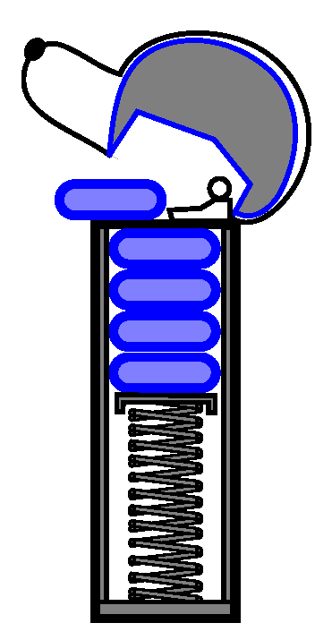
STACK
Stack
  The element deleted from the set is the one most recently inserted
  Last-in, First-out (LIFO)
Stack operations
  PUSH: Insert
  DELETE: Delete
  TOP: return the key value of the most recently inserted element
  STACK-EMPTY: check if the stack is empty
  STACK-FULL: check if the stack is full

Slide 14
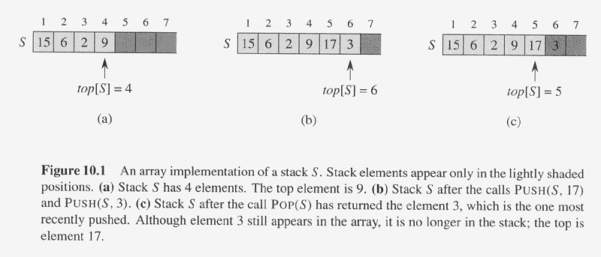
Represent Stack by Array
A stack of at most n elements can be implemented by an array S[1..n]
  top[S]: a pointer to the most recently inserted element
  A stack consists of elements S[1..top[S]]
    S[1]: the element at the bottom of the stack
    S[top[S]]: the element at the top

Slide 15
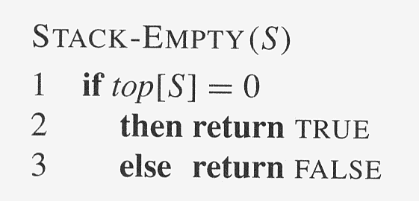
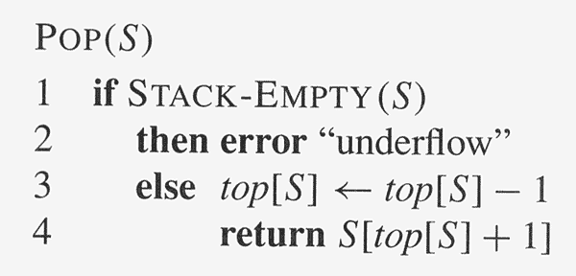
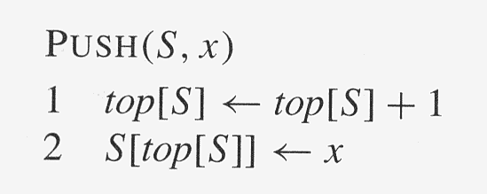
Stack Operations
How to implement
TOP(S), STACK-FULL(S) ?
O(1)

Slide 16
Stack Operations
TOP(S)
if STACK-EMPTY(S)
then return Error
else return S[top[S]]
STACK-FULL(S)
if top[S] = n then
then return TRUE
else return FALSE

Slide 17
PUSH
S
15
6
2
9
top[S]=4
PUSH(S, 17)
S
15
6
2
9
17
top[S] ← top[S] + 1 (top[S] = 5)
S[top[S]] ← x (S[5] = 17)
top[S]=4
top[S]=5

Slide 18
POP
S
15
6
2
9
17
3
top[S]=6
POP(S)
S
15
6
2
9
17
3
top[S] ← top[S] - 1 (top[S] = 5)
3
return S[top[S]+1] (return S[6])
top[S]=6
top[S]=5

Slide 19
QUEUE
Queue
  The element deleted is always the one that has been in the set for the longest time
  First-in, First-out (FIFO)
Queue operations
  ENQUEUE: Insert
  DEQUEUE: Delete
  HEAD: return the key value of the element that has been in the set for the longest time
  TAIL: return the key value of the element that has been in the set for the shortest time
  QUEUE-EMPTY: check if the stack is empty
  QUEUE-FULL: check if the stack is full

Slide 20
Represent Queue by Array
A queue of at most n-1 elements can be implemented by an array S[1..n]
  head[S]: a pointer to the element that has been in the set for the longest time
  tail[S]: a pointer to the next location at which a newly arriving element will be inserted into the queue
  The elements in the queue are in locations head[Q], head[Q]+1, …, tail[Q]-1
    The array is circular
  Empty queue: head[Q] = tail[Q]
    Initially we have head[Q] = tail[Q] = 1
  Full queue: head[Q] = tail[Q] + 1 (in circular (modular) sense)

Slide 21
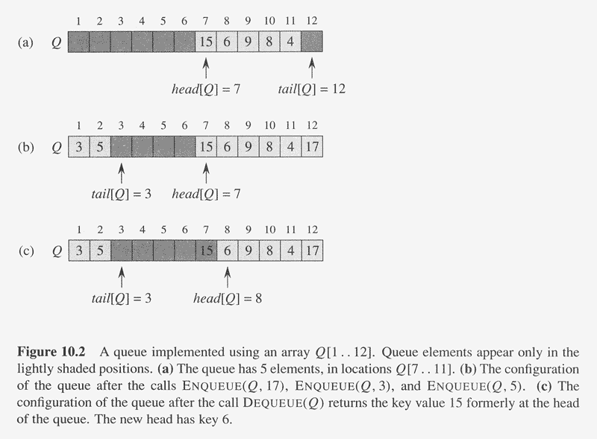
Illustration of A Queue

Slide 22
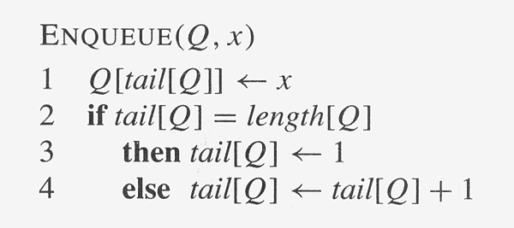
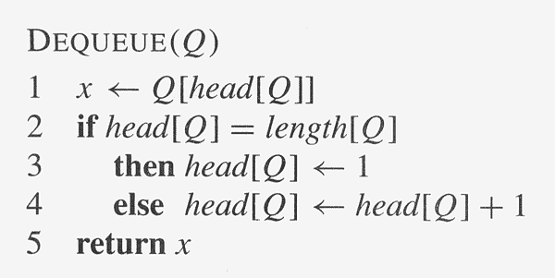
Queue Operations
O(1)

Slide 23
10.2. Linked Lists
A linked list is a data structure in which the objects are arranged in linear order
  The order in a linked list is determined by pointers in each object
Doubly linked list
  Each element is an object with a key field and two other pointer fields: next and prev, among other satellite fields. Given an element x
    next[x] points to its successor
      if x is the last element (called tail), next[x] = NIL
    prev[x] points to its predecessor
      if x is the first element (called head), prev[x] = NIL
  An attribute head[L] points to the first element of the list
    if head[L] = NIL, the list is empty

Slide 24
Linked Lists (Contd)
Singly linked list: omit the prev pointer in each element
Sorted linked list: the linear order of the list corresponds to the linear order of keys stored in elements of the list
  The minimum element is the head
  The maximum element is the tail
Circular linked list: the prev pointer of the head points to the tail, and the next pointer of the tail points to the head

Slide 25
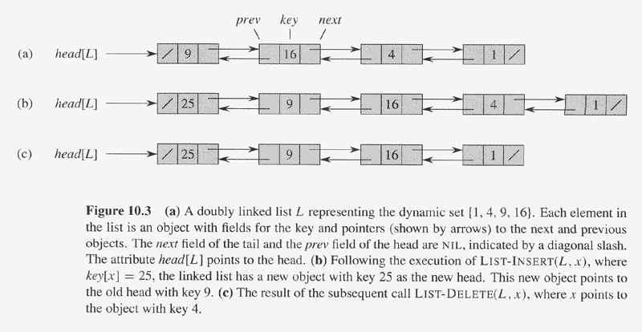
Illustration of A Doubly Linked List
NIL

Slide 26
Searching A Linked List
LIST-SEARCH(L, k): finds the first element with key k in list L by a simple linear search, returning a pointer to this element
  If no object with key k appears in the list, then NIL is returned
LIST-SEARCH(L, k)
1 x ← head[L]
2 while x ≠ NIL and key[x] ≠ k
3 do x ← next[x]
4 return x

Slide 27
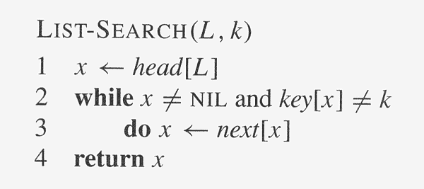
LIST-SEARCH
head[L]
/
9
16
4
1
/
x
x
x
LIST-SEARCH(L, 4)
How about LIST-SEARCH(L, 7)?

Slide 28
Inserting Into A Linked List
LIST-INSERT(L, x): given an element pointed by x, splice x onto the front of the linked list
LIST-INSERT(L, x)
1 next[x] ← head[L]
2 if head[L] ≠ NIL
3 then prev[head[L]] ← x
4 head[L] ← x
5 prev[x] ← NIL

Slide 29
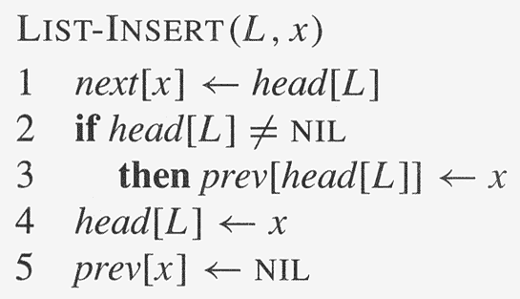
Illustration of LIST-INSERT
head[L]
/
9
16
4
1
/
LIST-INSERT(L, x) //key(x)=25
x
/
25

Slide 30
Deleting From A Linked List
LIST-DELETE(L, x): given an element pointed by x, remove x from the linked list
LIST-DELETE(L, x)
1 if prev[x] ≠ NIL
2 then next[prev[x]] ← next[x]
3 else head[L] ← next[x]
4 if next[x] ≠ NIL
5 then prev[next[x]] ← prev[x]

Slide 31
Illustration of LIST-DELETE
head[L]
prev[x]
x
next[x]
/
25
/
9
16
4
1
/
LIST-DELETE(L, x)
next[prev[x]] ← next[x]
Need garbage collection for x
prev[next[x]] ← prev[x]

Slide 32
Sentinel
A sentinel is a dummy object that allows us to simplify boundary conditions.
Simpler LIST-DELETE if we could ignore the boundary conditions at the head and tail of the list:
LIST-DELET′ (L, x)
1 next[prev[x]] ← next[x]
2 prev[next[x]] ← prev[x]
suppose that we provide with list L an object nil[L] that represents NIL but has all the fields of the other list elements. Wherever we have a reference to NIL in list code, we replace it by a reference to the sentinel nil[L].

Slide 33
10.3. Implementing Pointers and Objects
Some languages allow use of pointers (C, C++)
Some don’t: fortran.
How to implement pointers in such languages?

Slide 34
A Multiple-Array Representation of Objects
We can represent a collection of objects that have the same fields by using an array for each field.
  Figure 10.3 (a) and Figure 10.5
    For a given array index x, key[x], next[x], and prev[x] represent an object in the linked list
    A pointer x is simply a common index on the the key, next, and prev arrays
    NIL can be represented by an integer that cannot possibly represent an actual index into the array

Slide 35
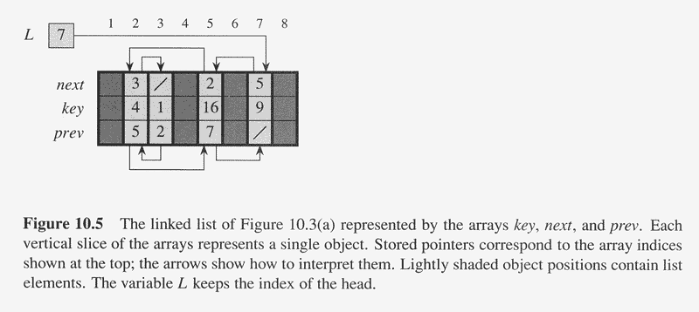
A Multiple-Array Representation of Objects Example

Slide 36
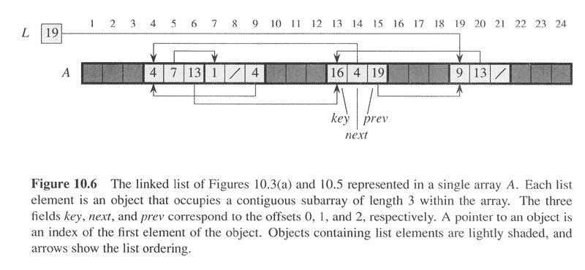
A Single-Array Representation of Objects
An object occupies a contiguous set of locations in a single array ➔ A[j..k]
  A pointer is simply the address of the first memory location of the object ➔ A[j]
  Other memory locations within the object can bed indexed by adding an offset to the pointer ➔ 0 ~ k-j
  Flexible but more difficult to manage

Slide 37
Allocating and Freeing Objects
To insert a key into a dynamic set represented by a linked list, we must allocate a pointer to a currently unused object in the linked-list representation
  It is useful to manage the storage of objects not currently used in the linked-list representation so that one can be allocated
Allocate and free homogeneous objects using the example of a doubly linked list represented by multiple arrays
  The arrays in the multiple-array representation have length m
  At some moment the dynamic set contains n ≤ m elements
  The remaining m-n objects are free → can be used to represent elements inserted into the dynamic set in the future

Slide 38
Free List
A singly linked list to keep the free objects
  Initially it contains all n unallocated objects
The free list is a stack
  Allocate an object from the free list ➔ POP
  De-allocate (free) an object ➔ PUSH
  The next object allocated the last one freed
Use only the next array to implement the free list
A variable free pointers to the first element in the free list
Each object is either in list L or in the free list, but not in both

Slide 39
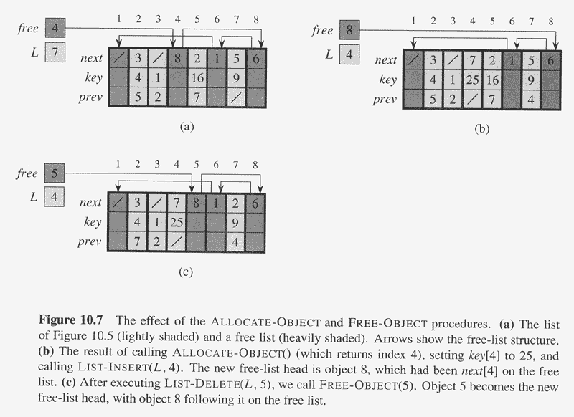
Free List Example

Slide 40
Allocate And Free An Object
ALLOCATE-OBJECT()
1 if free = NIL
2 then error "out of space"
3 else x ← free
4 free ← next[x]
5 return x
FREE-OBJECT(x)
1 next[x] ← free
2 free ← x

Slide 41
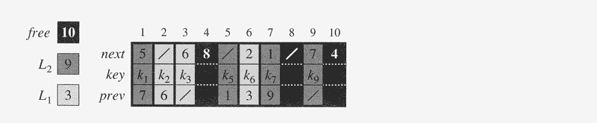
A Free List for Multiple Lists
Two linked lists, L1 (lightly shaded) and L2 (heavily shaded),
and a free list (darkened)
intertwined.

Slide 42
10.4.Representing Rooted Trees
The methods for representing lists given in the previous section extend to any homogeneous data structure.
In this section, we look specifically at the problem of representing rooted trees by linked data structures.

Slide 43
Binary Tree
Use linked data structures to represent a rooted tree
  Each node of a tree is represented by an object
  Each node contains a key field and maybe other satellite fields
  Each node also contains pointers to other nodes
For binary tree…
  Three pointer fields
    p: pointer to the parent ➔ NIL for root
    left: pointer to the left child ➔ NIL if no left child
    right: pointer to the right child ➔ NIL if no right child
  root[T] pointer to the root of the tree
    NIL for empty tree

Slide 44
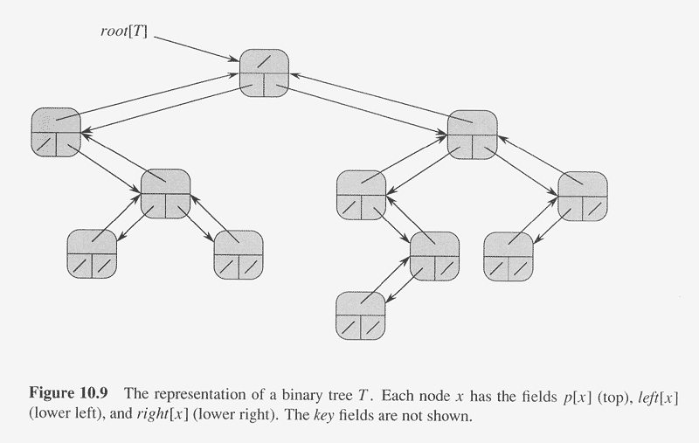

Slide 45
Draw the Binary Tree Rooted At Index 6
Index | Key | Left | Right
1 | 12 | 7 | 3
2 | 15 | 8 | NIL
3 | 4 | 10 | NIL
4 | 10 | 5 | 9
5 | 2 | NIL | NIL
6 | 18 | 1 | 4
7 | 7 | NIL | NIL
8 | 14 | 6 | 2
9 | 21 | NIL | NIL
10 | 5 | NIL | NIL
18
12
10
7
4
2
21
5

Slide 46
Rooted Trees With Unbounded Branches
The representation for binary trees can be extended to a tree in which no. of children of each node is at most k
  left, right ➔ child₁, child₂, …, child_{k}
If no. of children of a node can be unbounded, or k is large but most nodes have small numbers of children…
  Left-child, right sibling representation
    Three pointer fields
      p: pointer to the parent
      left-child: pointer to the leftmost child
      right-sibling: pointer to the sibling immediately to the right
    root[T] pointer to the root of the tree
    O(N) space for any n-node rooted tree

Slide 47
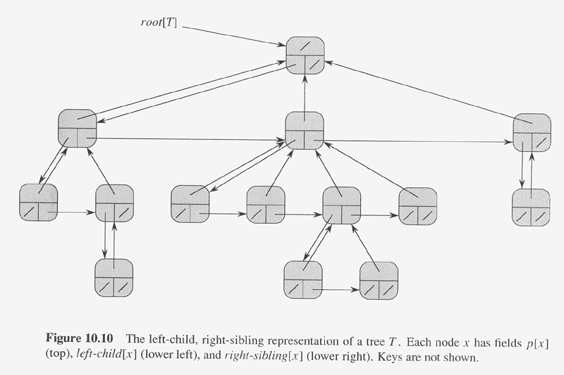

Slide 48
Summary
dynamic sets
dynamic set operations
stacks
queues
linked lists
array representation of linked lists
array representation of rooted trees

